Slide 2
By Kathryn Garcia- TPT

Slide 32
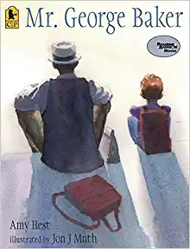
Mr. George Baker
By Amy Hest
Illustrated by Jon Muth

Slide 33
Make a connection with an older person in your neighborhood or a family member
Spend time together by reading with them, walking their pet, running and errand, play games, work on a puzzle together
Invite them to a school event, draw a picture or make them a gift, ask them to tell stories about when they were young.

Slide 34
